Slide 1

Hiring process analytics
Enhancing Recruitment Efficiency Through Data Analysis

Slide 2
Tech Stack
Trainity
powerpoint
SPREADSHEET

Slide 3
Introduction
Objective
Analyze hiring data to identify trends and improve recruitment strategies.
Importance
Helps in optimizing resource allocation, reducing time-to-hire, and enhancing candidate experience.

Slide 4

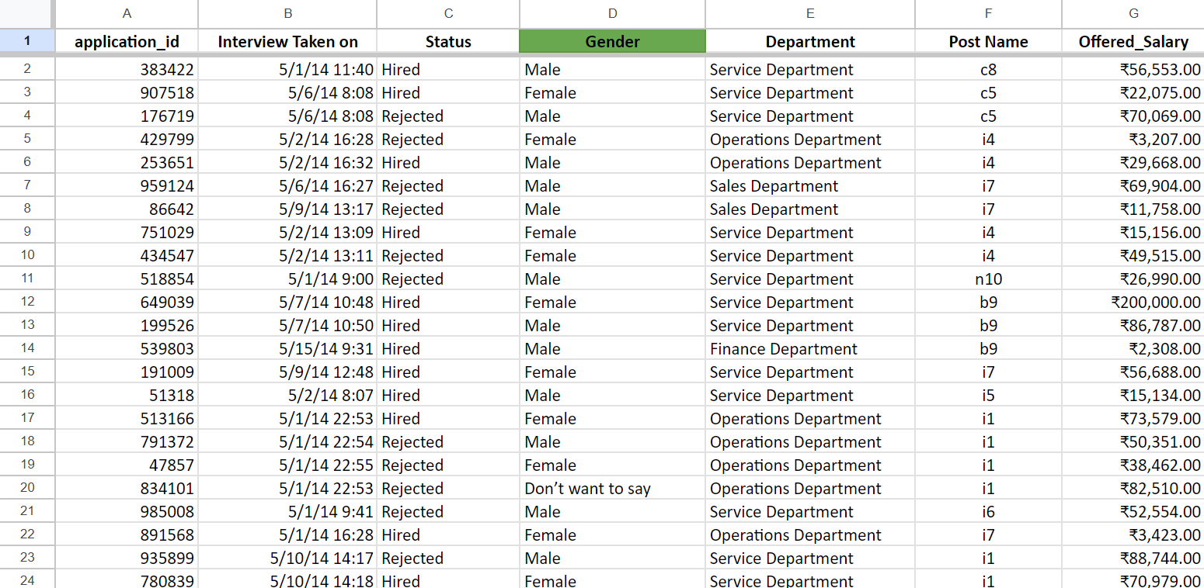
Dataset Overview
Columns
  Application ID
  Interview Date
  Status
  Gender
  Department
  Post Name
  Offered Salary
Data Handling
  Event name changed to Gender
  Missing values in Gender

Slide 5
Tasks Overview

Slide 6





SALARY ANALYSIS
Calculate the average salary offered by the company.
DEPARTMENT ANALYSIS
Visualize the proportion of people in different departments.
HIRING ANALYSIS
Determine the gender distribution of hires.
DISTRIBUTION ANALYSIS
Create class intervals for salaries.
POST ANALYSIS
Visualize the distribution of positions across tiers.

Slide 7
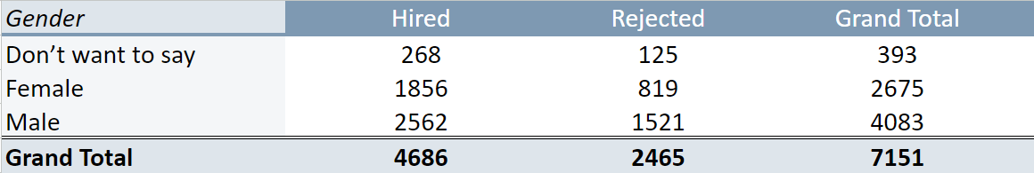
Hiring Analysis
Objective :
  Determine the gender distribution of hires.
Gender Distribution :
  Females Hired - 33 %
  Total Males Hired - 54 %
Insights : Gender parity in hiring trends.

Slide 8

Salary Analysis
Objective :
  Calculate the average salary offered by the company
Formula Used :
  Average Salary :
  = AVERAGE(range_of_salaries)
Insights : Average and distribution of salaries to assess equity.

Slide 9
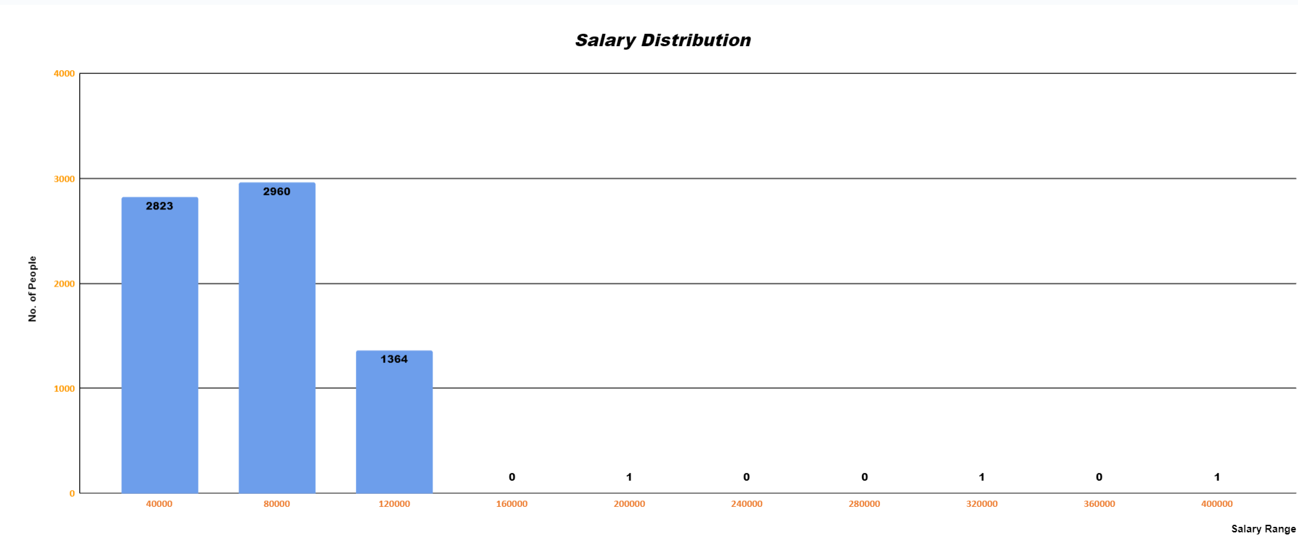
Salary Distribution Analysis
Objective :
  Create class intervals for salaries.
Salary Range :
  Min Salary - 800 Rs
  Max Salary - 4,00,000 Rs
Insights : Most employees fall within ₹40,000 -₹80,000, with fewer in higher salary ranges, indicating potential clustering or role specialization.

Slide 10
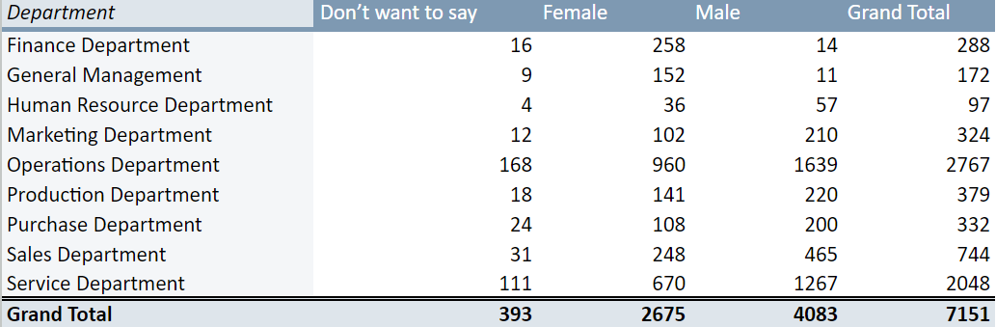
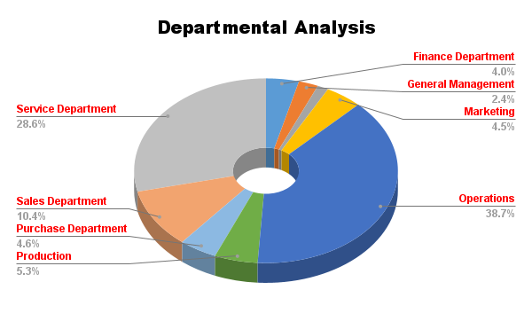
Departmental Analysis
Objective :
  Visualize the proportion of people in different departments.
Method :
  Creating a Pivot Table and Pie chart
Insights : Departmental composition for resource allocation.

Slide 11
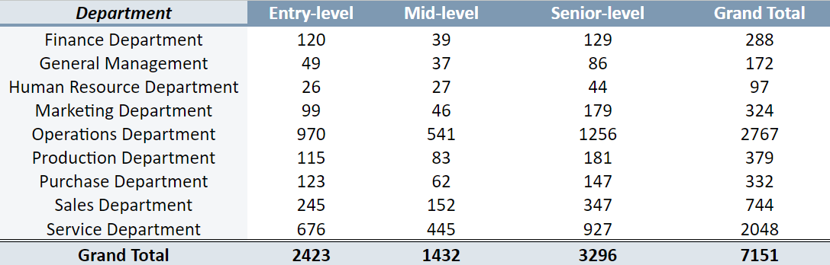
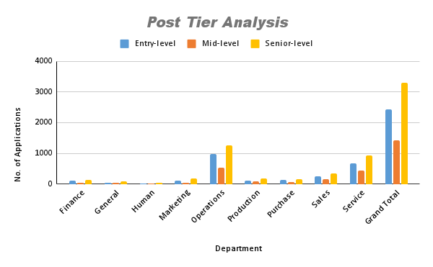
Post Tier Analysis
Objective :
  Visualize the distribution of positions across tiers.
Method :
  Creating a Pivot Table and Bar chart
Insights : Position tier distribution to identify gaps or over-represented tiers.

Slide 12
Key Insights
Finding 1: Gender ratio shows 54 % males and 33 % females.
Finding 2: Majority of Applications fall within 40,000 – 80,000.
Finding 3: Most hires are in the Operations Department.

Slide 13
Spreadsheet
Hiring Process Analysis
Conclusion :
  Summary : Data-driven insights provide actionable improvements for hiring efficiency.
  Next Steps : Implement recommendations and monitor changes in future hiring cycles.

